Slide 1
Chess errors
Daniel Merlini

Slide 2
bitboards

Slide 3
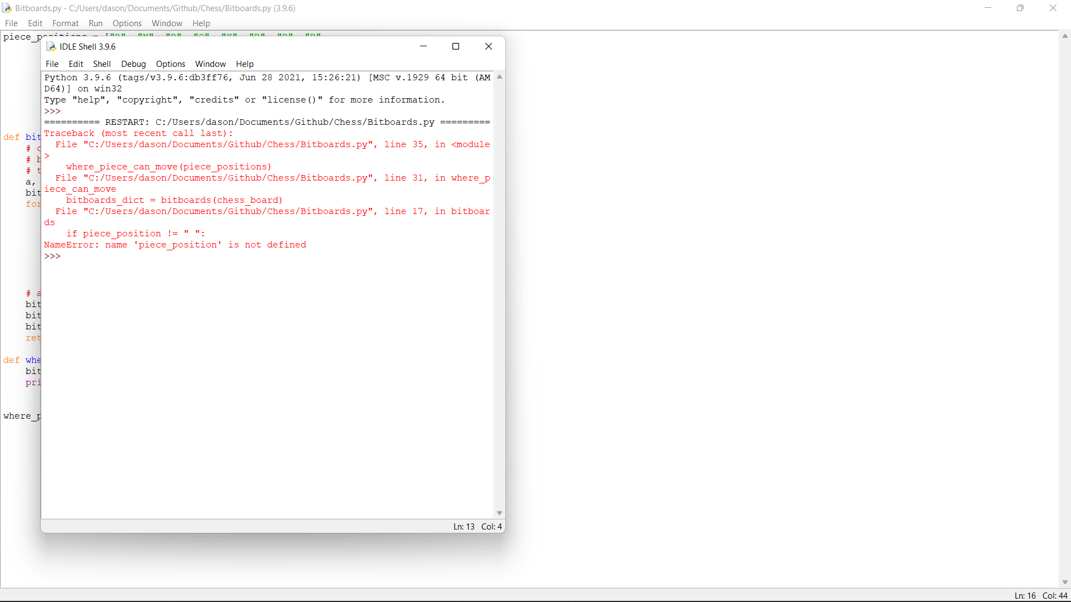

Slide 4
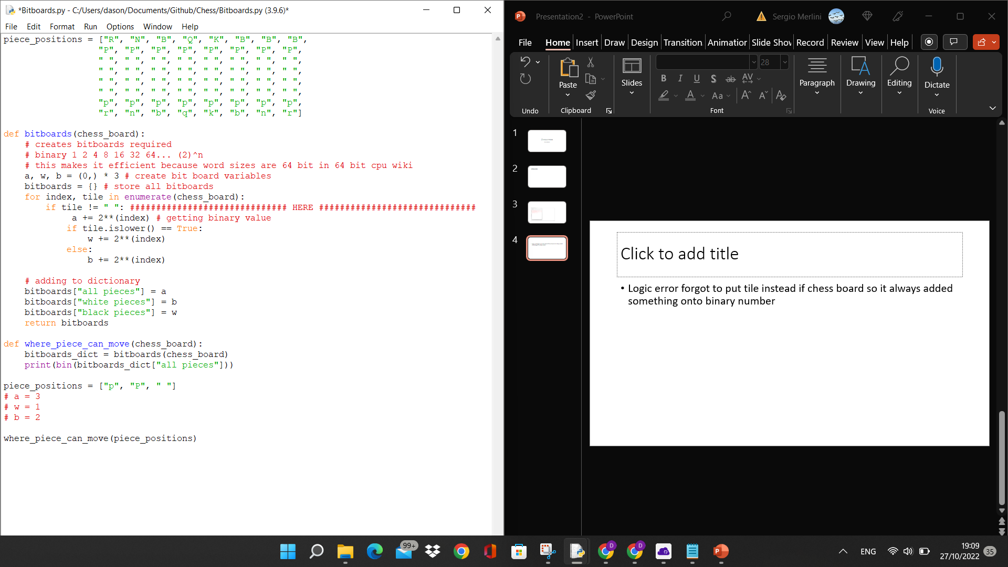
Logic error forgot to put tile instead if chess board so it always added something onto binary number

Slide 5
Syntax error – doesn’t match indentation

